Slide 1

Restaurant information system
Dương Thành Long
Phạm Lê Anh Khôi
Github: github.com/CheetoBuri/Restuarant-Information-System

Slide 2
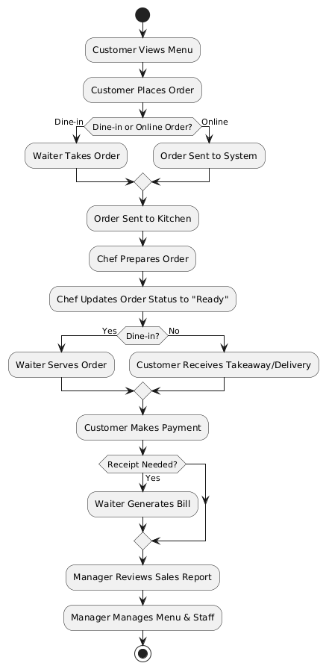
General WorkFlow

Slide 3
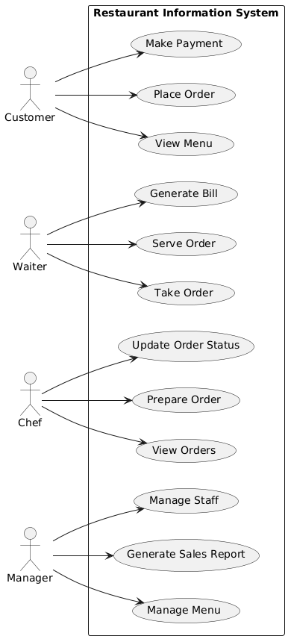
Use Case Diagram

Slide 4
Customer Use Cases
Use Case Name | View Menu
Scenario | Customer views the restaurant’s menu.
Triggering Event | Customer wants to browse available food items.
Brief Description | The customer accesses the restaurant system to view the menu, which displays available dishes, prices, and descriptions.
Actors | Customer
Related Use Cases | Place Order
Stakeholders | Customers, Marketing, Sales
Preconditions | Menu data must be available in the system.
Postconditions | Customer can view menu details.
Flow of Activities | Actor 1. Customer requests to view the menu. | System 1.1 System retrieves menu items. 1.2 System displays menu with item descriptions and prices.
Exception Conditions | 1.1 Menu data is unavailable or system error occurs.

Slide 5
Customer Use Cases
Use Case Name | Place Order
Scenario | Customer places a food order.
Triggering Event | Customer selects food items and proceeds to order.
Brief Description | The customer selects food items from the menu and places an order, which is sent to the kitchen for preparation.
Actors | Customer
Related Use Cases | View Menu, Make Payment
Stakeholders | Customers, Kitchen Staff, Waiters
Preconditions | The menu must be available, and the restaurant must be accepting orders.
Postconditions | Order is saved in the system and sent to the kitchen.
Flow of Activities | Actor Customer selects items from the menu. Customer confirms order. | System 1.1 System adds items to order. 2.1 System validates the order and calculates total cost. 2.2 System generates an order ID and sends it to the kitchen.
Exception Conditions | 1. Selected menu item is unavailable. 2. System fails to validate order (e.g., incorrect quantity).

Slide 6
Customer Use Cases
Use Case Name | Make Payment
Scenario | Customer completes payment for an order.
Triggering Event | Customer decides to pay for their order.
Brief Description | The customer selects a payment method and completes the transaction.
Actors | Customer
Related Use Cases | Place Order
Stakeholders | Customers, Accounting
Preconditions | A valid order must exist.
Postconditions | Payment is processed and recorded.
Flow of Activities | Actor Customer requests bill. Customer selects payment method and enters details. | System 1.1 System generates the bill and displays payment options. 2.1 System processes payment via the selected method. 2.2 System confirms payment and generates receipt.
Exception Conditions | 1. Payment fails due to insufficient funds or network issues.

Slide 7
Waiter Use Cases
Use Case Name | Take Order
Scenario | Waiter takes a customer’s order.
Triggering Event | Customer provides order details to the waiter.
Brief Description | The waiter inputs the customer’s order into the system, which then sends it to the kitchen.
Actors | Waiter
Related Use Cases | Place Order, Prepare Order
Stakeholders | Customers, Kitchen Staff, Waiters
Preconditions | The restaurant must be open and accepting orders.
Postconditions | The order is registered in the system and sent to the kitchen.
Flow of Activities | Actor 1. Waiter inputs the customer’s order. | System 1.1 System saves the order and assigns an order ID. 1.2 System sends the order to the kitchen.
Exception Conditions | 1. System fails to register the order.

Slide 8
Waiter Use Cases
Use Case Name | Serve Order
Scenario | Waiter serves the prepared order to the customer.
Triggering Event | The kitchen completes an order.
Brief Description | When food is ready, the waiter picks up the order and serves it to the customer.
Actors | Waiter
Related Use Cases | Prepare Order
Stakeholders | Customers, Kitchen Staff
Preconditions | The order must be prepared and ready.
Postconditions | The customer receives their order.
Flow of Activities | Actor Waiter checks if the order is ready. Waiter picks up the order and delivers it. | System 1.1 System displays order status. 2.1 System updates order status to "Served".
Exception Conditions | 1. Order status is incorrect or missing.

Slide 9
Waiter Use Cases
Use Case Name | Generate Bill
Scenario | System generates a bill for the customer.
Triggering Event | Customer requests the bill.
Brief Description | The waiter or system generates a bill based on the customer’s order.
Actors | Waiter, Customer
Related Use Cases | Make Payment
Stakeholders | Customers, Accounting
Preconditions | The order must exist.
Postconditions | The customer receives the bill.
Flow of Activities | Actor 1. Customer requests the bill. | System 1.1 System retrieves order details. 1.2 System calculates the total amount. 1.3 System generates and displays the bill.
Exception Conditions | 1. Order details are missing or incorrect.

Slide 10
Chef Use Cases
Use Case Name | View Order
Scenario | Chef checks the list of received orders.
Triggering Event | Chef wants to see the pending orders to prepare them.
Brief Description | The system retrieves and displays a list of orders for the chef, including details such as items ordered, quantity, and special requests.
Actors | Chef
Related Use Cases | Update Order Status
Stakeholders | Kitchen Staff, Management
Preconditions | There must be at least one pending order in the system.
Postconditions | The chef can see the order details and proceed with preparation.
Flow of Activities | Actor 1. Chef requests to view pending orders. | System 1.1 System retrieves a list of pending orders. 1.2 System displays the order details.
Exception Conditions | 1. No pending orders exist.

Slide 11
Chef Use Cases
Use Case Name | Prepare Order
Scenario | Chef prepares the customer’s order.
Triggering Event | The system sends a new order to the kitchen.
Brief Description | The chef receives and prepares the order before notifying staff that it is ready.
Actors | Chef
Related Use Cases | Take Order, Serve Order
Stakeholders | Customers, Kitchen Staff
Preconditions | The order must exist in the system.
Postconditions | The order is marked as ready for serving.
Flow of Activities | Actor 1. Chef views pending orders. 2. Chef prepares the order. 3. Chef finishes preparation. | System 1.1 System displays orders marked as "Pending". 2.1 System updates order status to "In Progress". 3.1 System marks order as "Ready".
Exception Conditions | 1. System does not display pending orders.

Slide 12
Chef Use Cases
Use Case Name | Update Order Status
Scenario | Chef updates the order status.
Triggering Event | Chef needs to update the status of an order (e.g., from "In Progress" to "Ready").
Brief Description | The order status is updated by the chef, and the system reflects the change.
Actors | Chef
Related Use Cases | Prepare Order, Serve Order, View Order
Stakeholders | Customers, Kitchen Staff, Waiters
Preconditions | The order must exist and have a valid status.
Postconditions | Order status is updated in the system.
Flow of Activities | Actor Chef selects an order. Chef updates the order status. | System 1.1 System retrieves order details 2.1 System updates order status accordingly..
Exception Conditions | Order does not exist. System fails to update order status due to an error.

Slide 13
Manage Use Cases
Use Case Name | Manage Staff
Scenario | Manager adds, updates, or removes staff members.
Triggering Event | The Manager needs to modify staff information.
Brief Description | The Manager can add new staff, update existing staff details, or remove staff from the system.
Actors | Manager
Related Use Cases | None
Stakeholders | HR, Management
Preconditions | The system must have valid authentication for the manager.
Postconditions | Staff data is updated in the system.
Flow of Activities | Actor Manager selects "Manage Staff". Manager selects an action (Add/Update/Remove). | System 1.1 System displays staff list and options (Add, Update, Remove). 2. 1 Manager selects an action (Add/Update/Remove).
Exception Conditions | Manager selects an action (Add/Update/Remove). System fails to update records.

Slide 14
Manager Use Cases
Use Case Name | Manage Menu
Scenario | Manager updates the restaurant menu.
Triggering Event | Manager needs to modify menu items.
Brief Description | The Manager can add new menu items, update existing ones, or remove items from the menu.
Actors | Manager
Related Use Cases | View Menu
Stakeholders | Customers, Management
Preconditions | The system must authenticate the manager.
Postconditions | The menu is updated in the system.
Flow of Activities | Actor Manager selects "Manage Menu". 2. Manager selects an action (Add/Update/Remove). | System 1.1 System displays menu list and options (Add, Update, Remove). 2.1 System processes the request and updates menu records.
Exception Conditions | Menu data is incomplete or invalid. System fails to update menu records.

Slide 15
Manager Use Cases
Use Case Name | Generate Sales Report
Scenario | Manager generates a report of sales.
Triggering Event | Manager wants to view a summary of sales data.
Brief Description | The system compiles and displays a report summarizing sales over a specified period.
Actors | Manager
Related Use Cases | Make Payment
Stakeholders | Accounting, Management
Preconditions | Sales data must exist in the system.
Postconditions | A sales report is generated.
Flow of Activities | Actor 1. Manager requests a sales report. | System 1.1 System retrieves sales data. 1.2 System compiles the data into a report. 1.3 System displays the report.
Exception Conditions | No sales data available. System error prevents report generation.

Slide 16
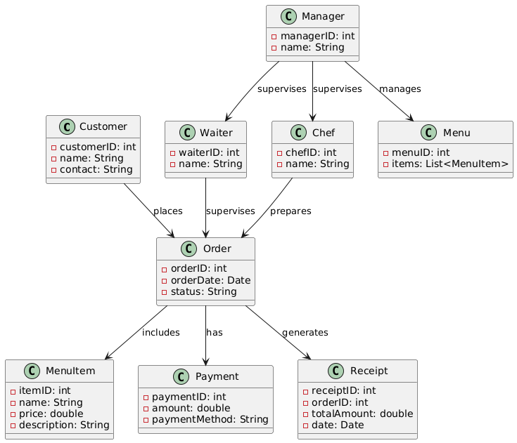
Domain Class Model Diagram

Slide 17
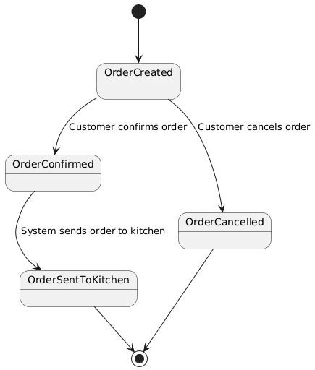
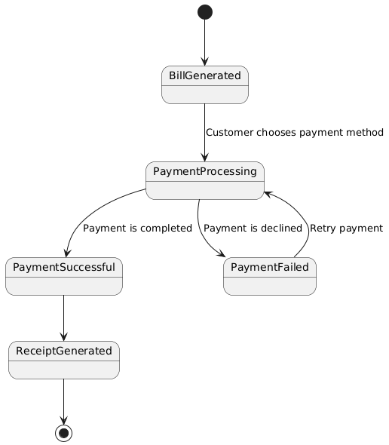
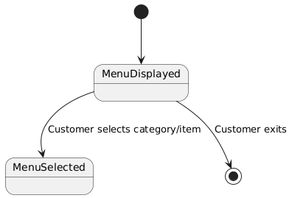
State Machine Diagram for Customer
View Menu
Place Order
Make Payment

Slide 18
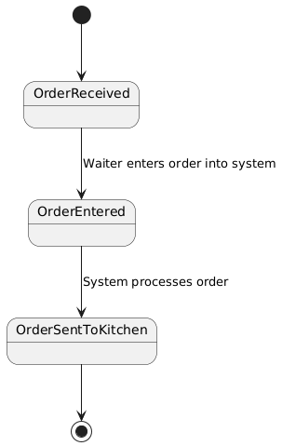
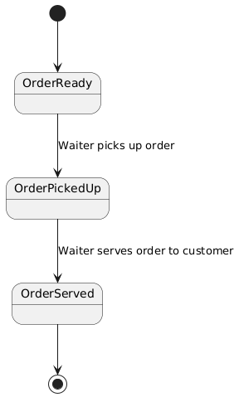
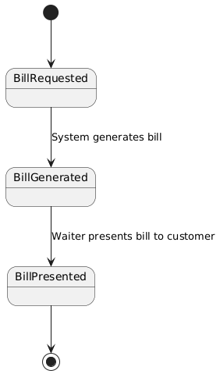
State Machine Diagram for Waiter
Take Order
Serve Order
Generate Bill

Slide 19
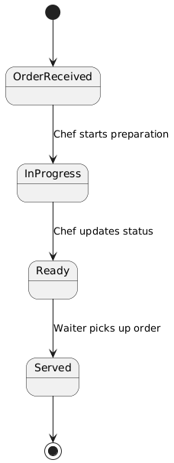
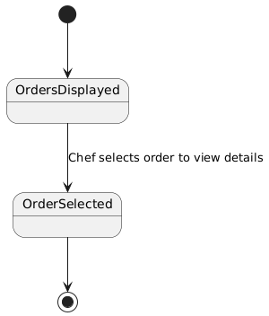
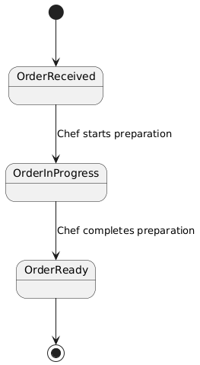
State Machine Diagram for Chef
View Order
Prepare Order
Update Order Status

Slide 20
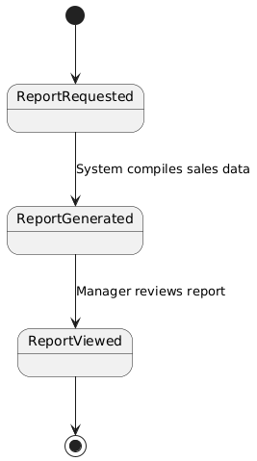
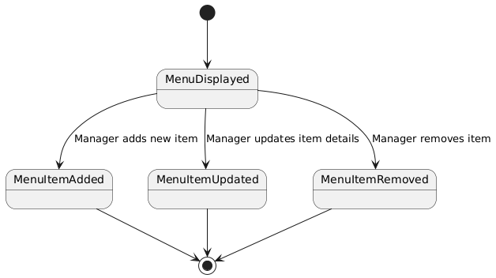
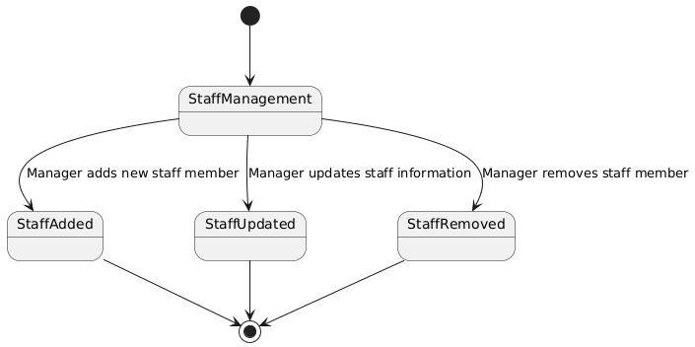
State Machine Diagram for Manager
Generate Sales Report
Manage Menu
Manage Staff

Slide 21
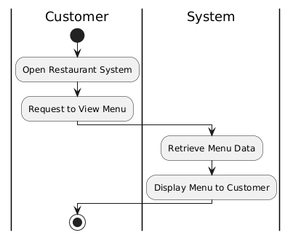
Activity Diagram: View Menu

Slide 22
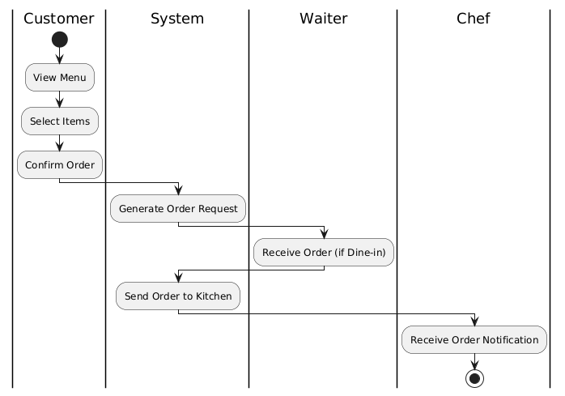
Activity Diagram: Place Order

Slide 23
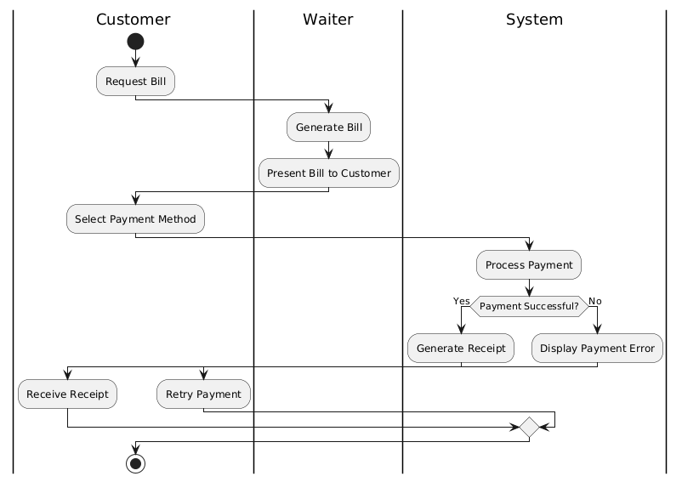
Activity Diagram: Make Payment

Slide 24
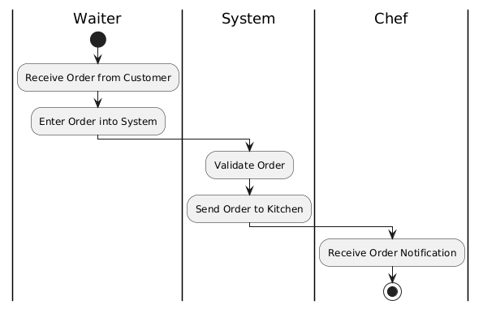
Activity Diagram: Take Order

Slide 25
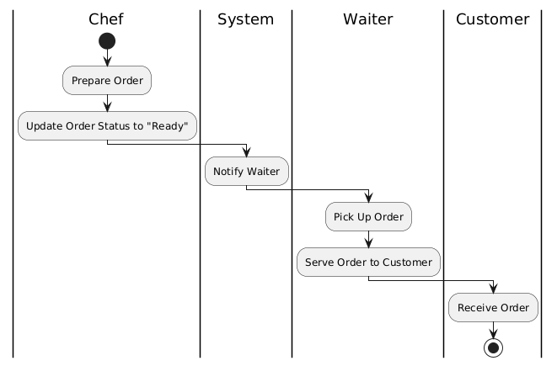
Activity Diagram: Take Order

Slide 26
Activity Diagram: Server Order

Slide 27
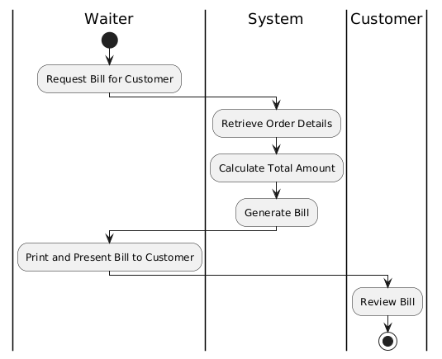
Activity Diagram: Generate Bill

Slide 28
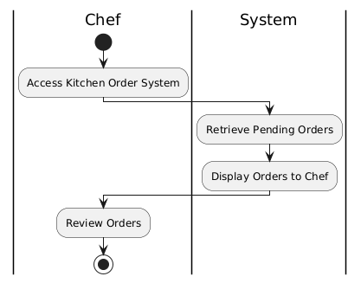
Activity Diagram: View Orders

Slide 29
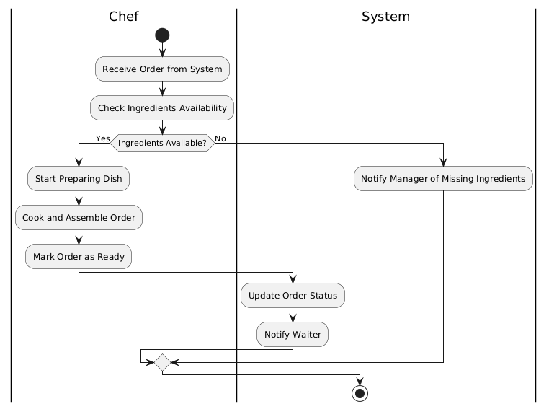
Activity Diagram: Prepare Order

Slide 30
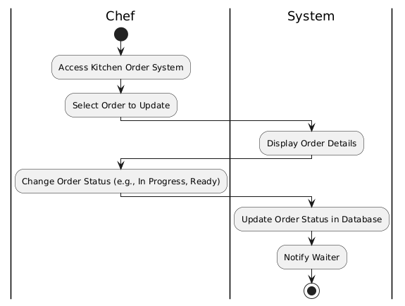
Activity Diagram: Update Order Status

Slide 31
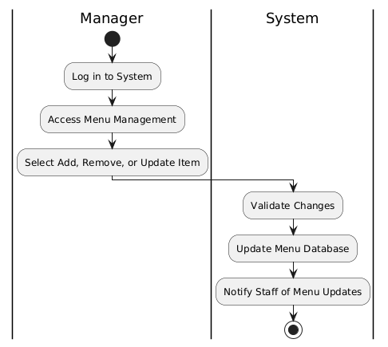
Activity Diagram: Manage Menu

Slide 32
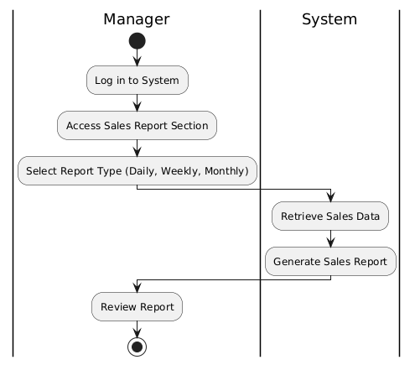
Activity Diagram: Generate Sales Report

Slide 33
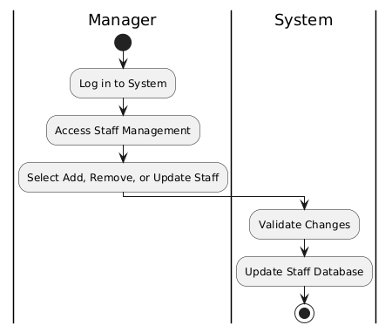
Activity Diagram: Manage Staff

Slide 34
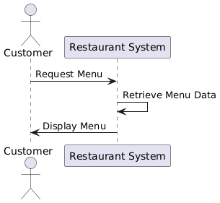
System Sequence Diagram: View Menu

Slide 35
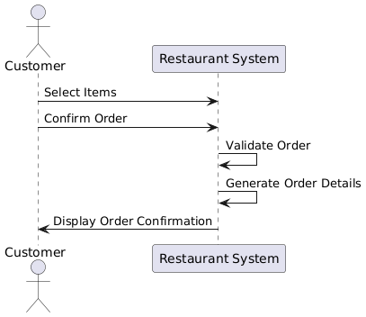
System Sequence Diagram: Place Order

Slide 36
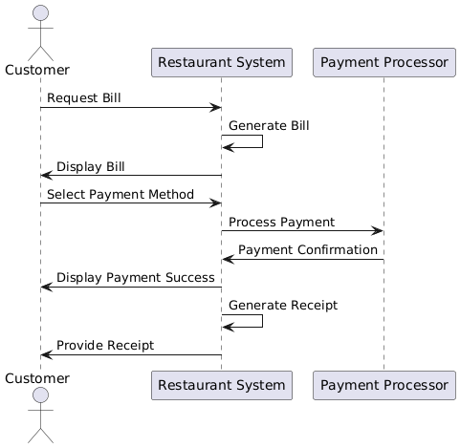
System Sequence Diagram: Make Payment

Slide 37
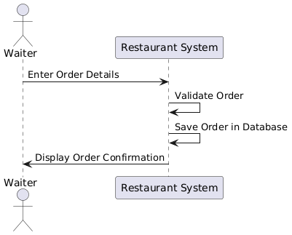
System Sequence Diagram: Take Order

Slide 38
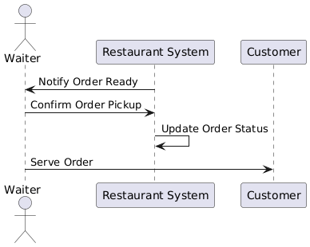
System Sequence Diagram: Serve Order

Slide 39
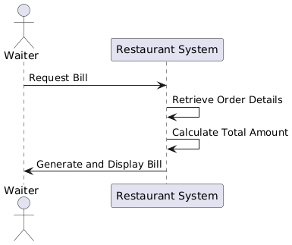
System Sequence Diagram: Generate Bill

Slide 40
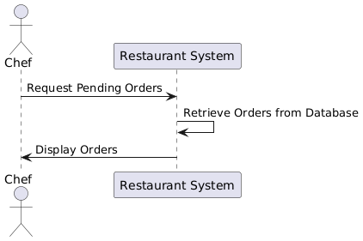
System Sequence Diagram: View Orders

Slide 41
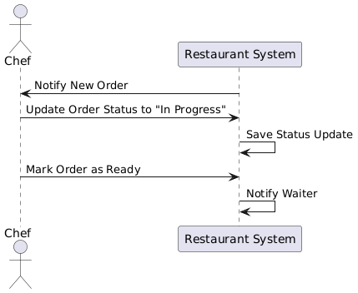
System Sequence Diagram: Prepare Order

Slide 42
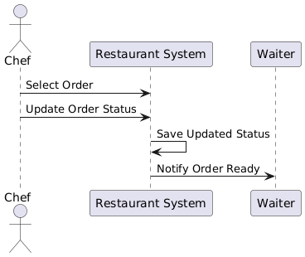
System Sequence Diagram: Update Order Status

Slide 43
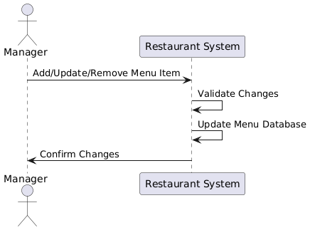
System Sequence Diagram: Manage Menu

Slide 44
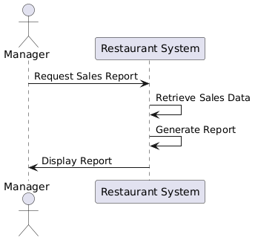
System Sequence Diagram: Generate Sales Report

Slide 45
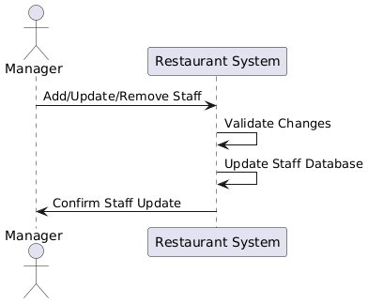
System Sequence Diagram: Manage Staff

Slide 46
CRUD Verification Table
Actor | CRUD | Verified Use Case
Customer | Create | Place order, Create customer account
 | Read | View menu
 | Update | Update customer information
 | Delete | Delete customer account

Slide 47
CRUD Verification Table
Actor | CRUD | Verified Use Case
Waiter | Create | Place order on behalf of customer
 | Read | View menu, View order
 | Update | Update order status
 | Delete | Cancel order

Slide 48
CRUD Verification Table
Actor | CRUD | Verified Use Case
Chef | Create | None
 | Read | View order
 | Update | Update order status
 | Delete | None

Slide 49
CRUD Verification Table
Actor | CRUD | Verified Use Case
Manager | Create | Add menu item, Add staff, Generate sales report
 | Read | View menu, View sales report
 | Update | Update menu, Update staff information, Refresh sales report
 | Delete | Remove menu item, Remove staff, Archive sales report

Slide 50
Environment
Frontend: React.js / Vue.js
Backend: Node.js (Express) / Django / Spring Boot
Database: MySQL / PostgreSQL / MongoDB
Hosting: AWS / Azure / Firebase
Authentication: OAuth / JWT / Firebase Auth

Slide 51
Application Components
Customer Module: Account creation, order placement, and menu browsing
Waiter Module: Order management, updating order status
Chef Module: Viewing orders, updating preparation status
Manager Module: Menu management, staff management, sales reports
Payment Module: Integrates with Stripe/PayPal for secure transactions

Slide 52
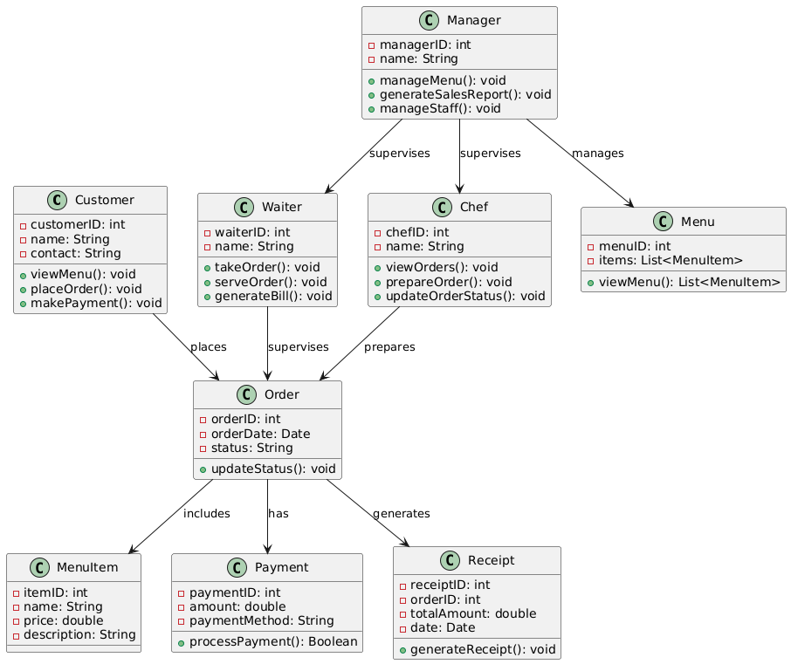
Design Class Diagram

Slide 53
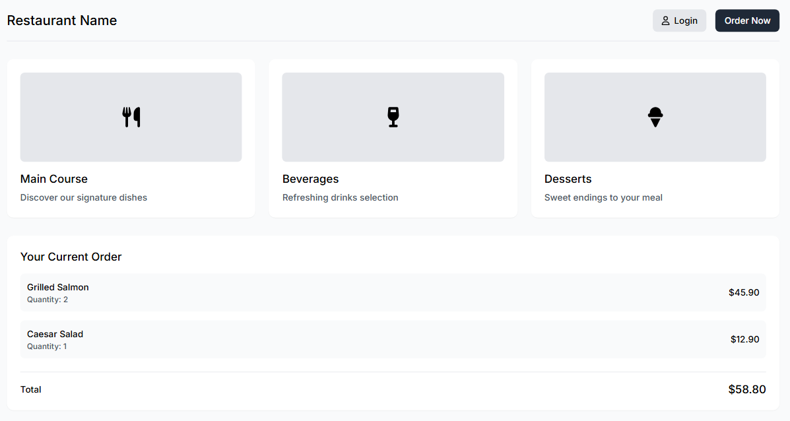
Wireframe: Customer

Slide 54
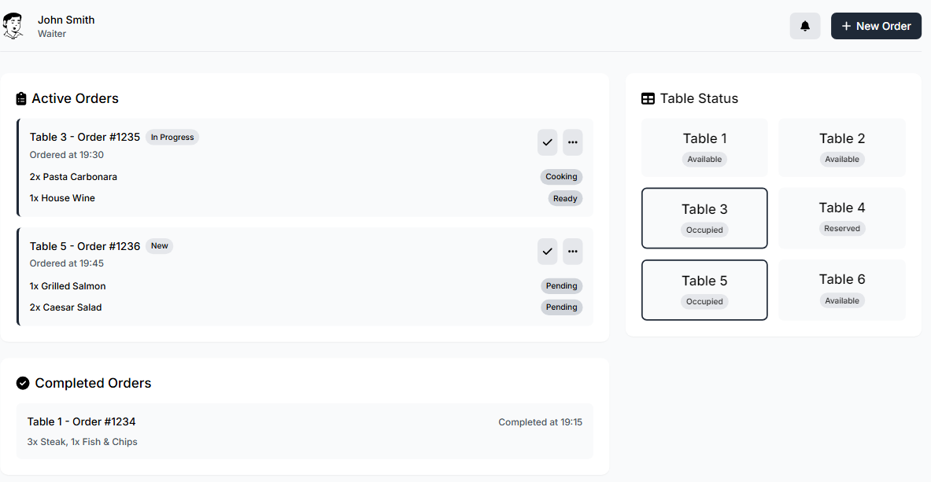
Wireframe: Waiter

Slide 55
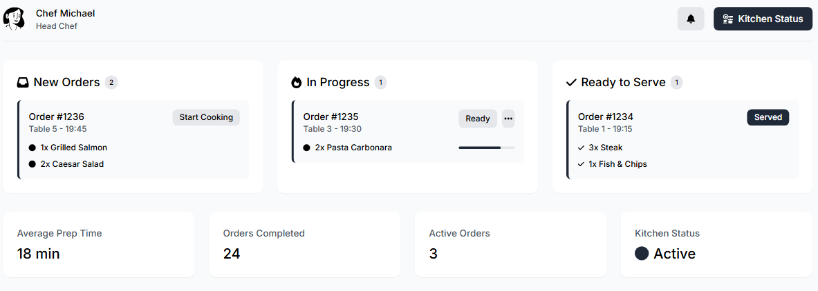
Wireframe: Chef

Slide 56
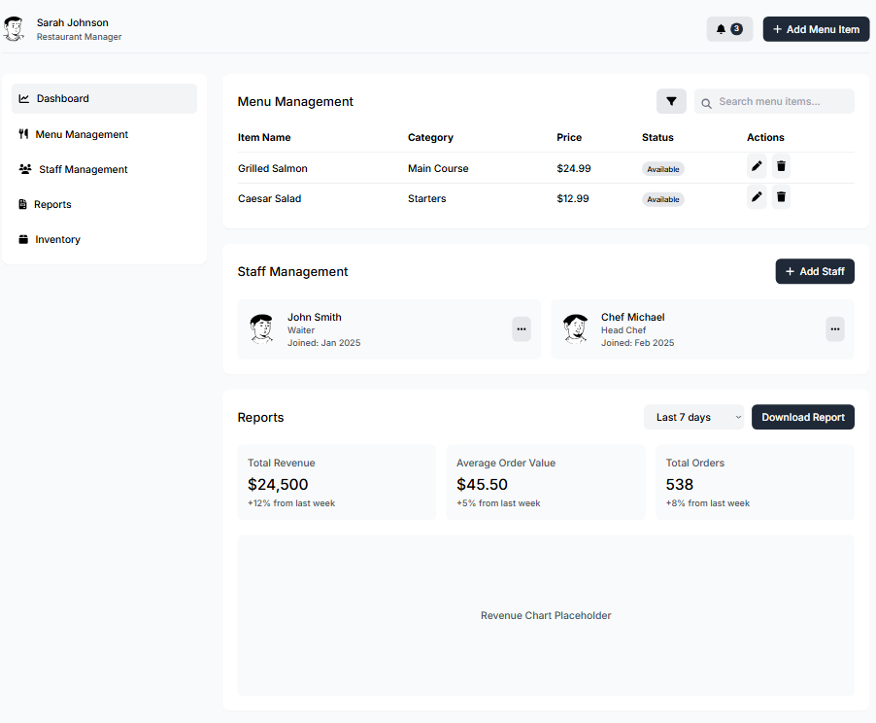
Wireframe: Manager

